Slide 1
Advanced ML Engineering

Slide 2
Chapter Introduction
Purpose of Advanced ML Engineering: Addresses challenges with large models and datasets that require scalable training.
Key Concepts Covered: Distributed training, model parallelism, inference optimization.
Relevance for ML Engineers: Essential skills for handling large-scale ML systems and reducing latency in inference.
Chapter Sections: Distributed training methods, low-latency inference, hands-on lab overview.

Slide 3
Distributed Training Overview
Why Distributed Training? Enables handling of massive datasets and complex models by spreading tasks across multiple devices.
Key Distributed Approaches: Data parallelism and model parallelism.
Challenges with Single-Device Training: Memory and latency limitations for large-scale models.
Typical Frameworks Used: TensorFlow, PyTorch, SageMaker for scaling out computation.

Slide 4
Data Parallelism in Distributed Training
Core Idea: Splits dataset across devices, each processing a subset in parallel.
Gradient Calculation and Synchronization: Each device computes gradients, then syncs with others for global model updates.
Benefits: Faster training by parallelizing data processing.

Slide 5
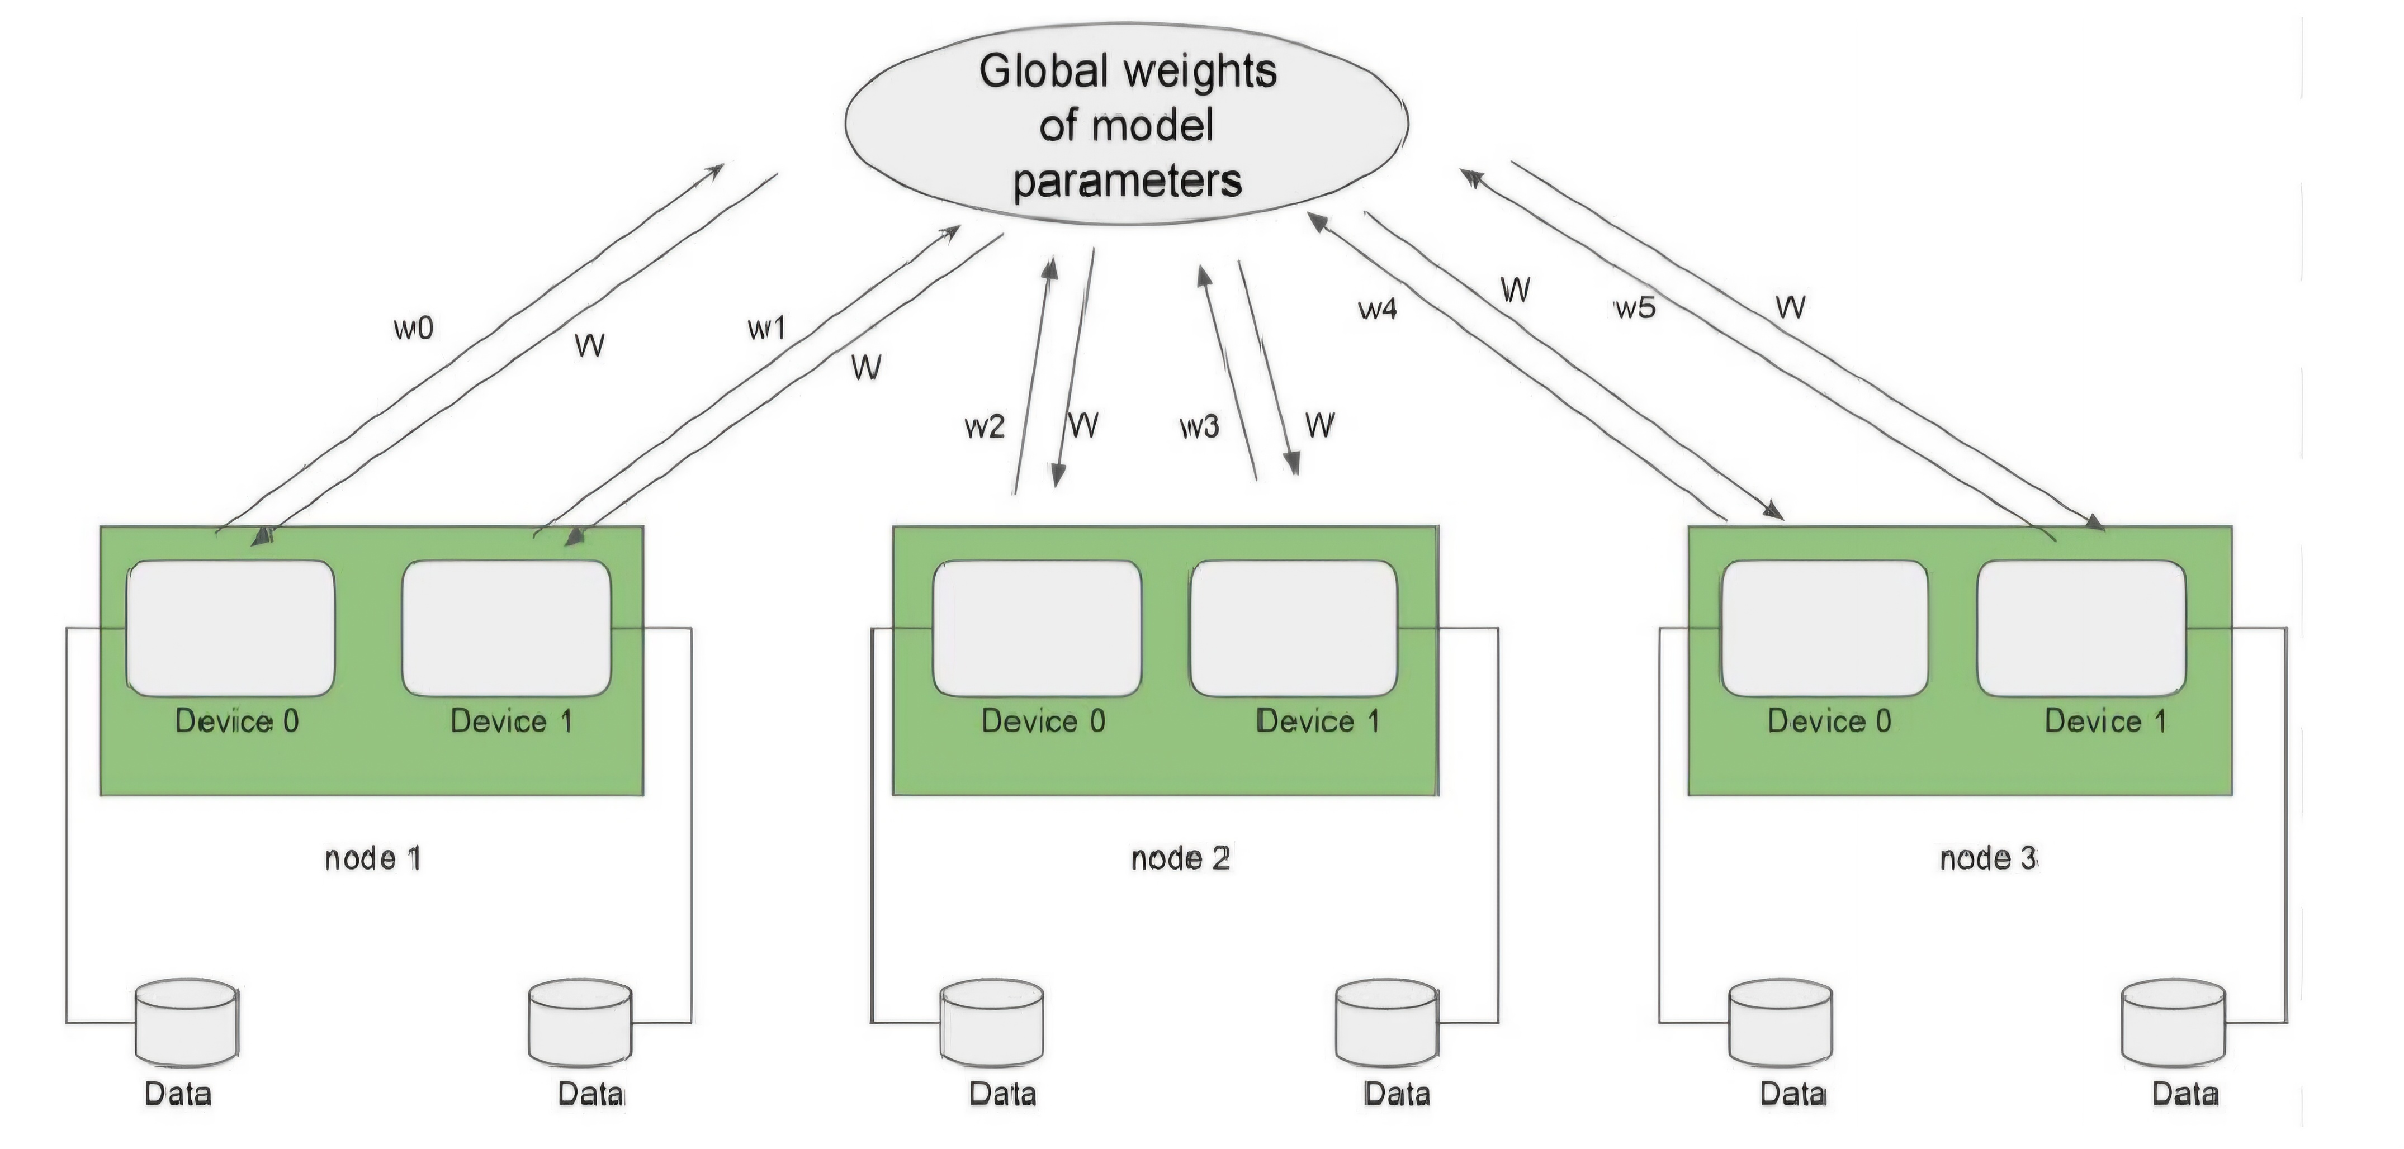
Data parallelism concept

Slide 6
Parameter Server (PS) in Data Parallelism
Role of PS Architecture: Server nodes aggregate gradients, while worker nodes compute them.
Synchronization Methods: Synchronous updates ensure gradient consistency, but may slow training.
Limitations: PS can become a bottleneck as model size and worker count increase.

Slide 7
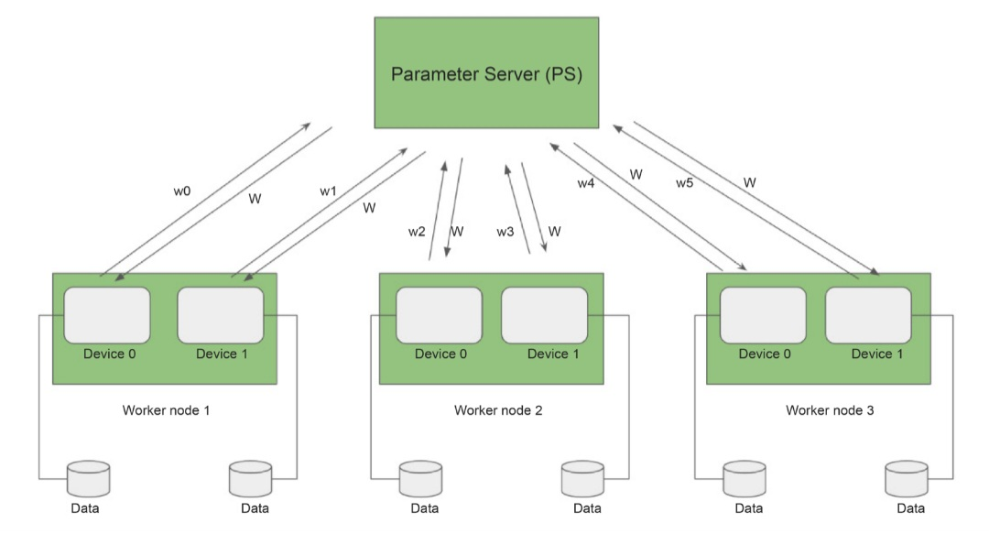
Parameter server architecture

Slide 8
AllReduce in Data Parallelism
AllReduce Overview: Eliminates the need for PS by allowing each worker to aggregate and update gradients independently.
Ring AllReduce Variation: Uses ring communication to reduce network load, passing gradients efficiently between nodes.
Scalability Advantage: Better suited for large models and clusters by distributing load across nodes.

Slide 9
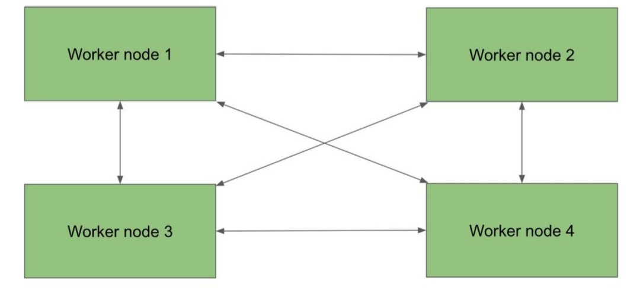
AllReduce architecture

Slide 10
Model Parallelism Overview
Purpose: Split large models across devices to manage memory constraints.
Applicability: Useful for massive models like GPT or BERT that exceed single-device memory.
Two Main Methods: Layer splitting and tensor slicing.

Slide 11
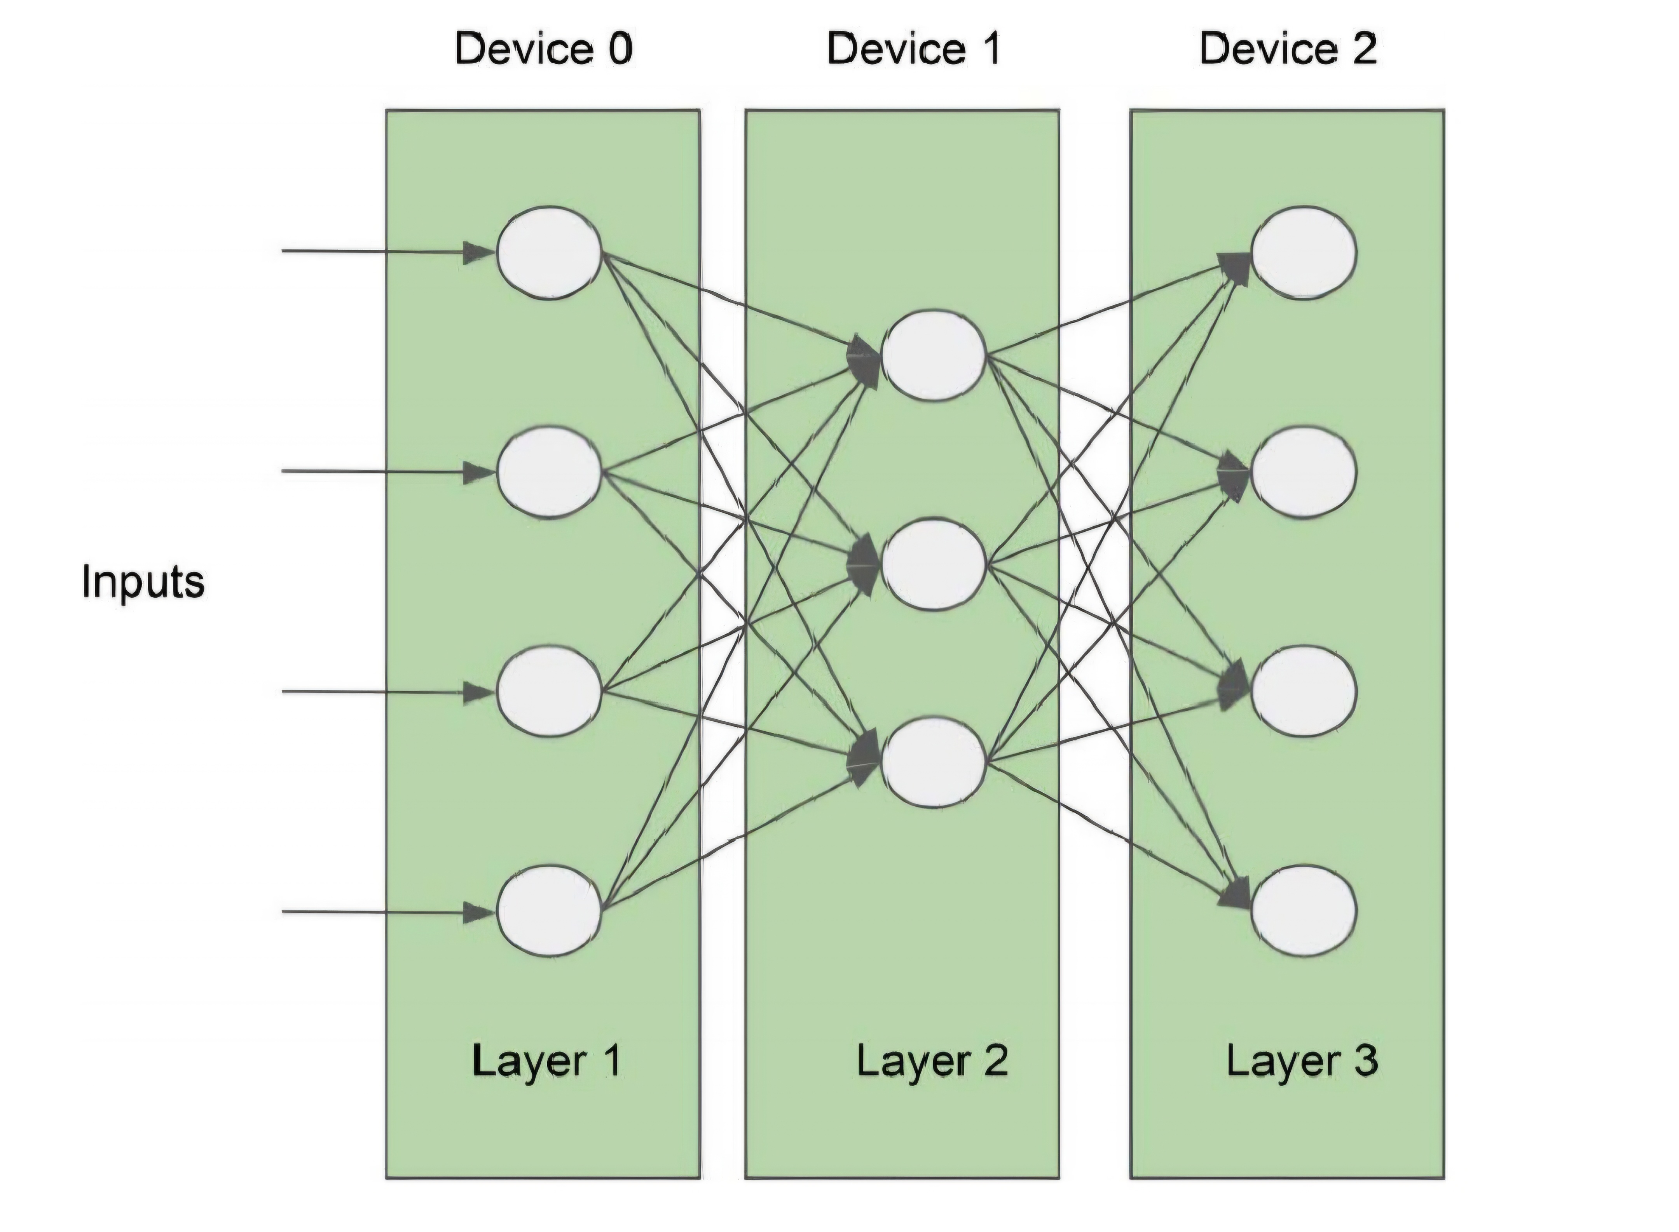
Naïve model parallelism

Slide 12
Pipeline Model Parallelism
Concept of Pipelines: Processes mini-batches sequentially, allowing devices to work in parallel stages.
Higher Resource Utilization: Reduces idle time by processing mini-batches continuously.
Variations: Includes interleaved pipelines for additional efficiency.

Slide 13
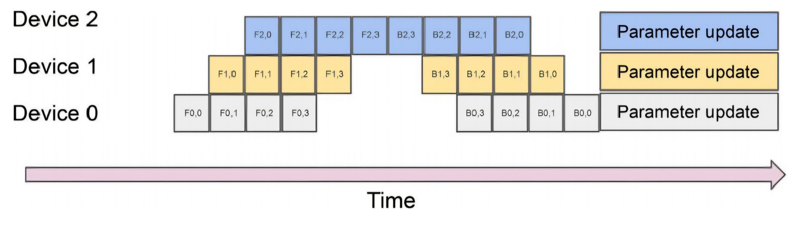
Pipeline model parallelism

Slide 14
Tensor Parallelism (Tensor Slicing)
Tensor Splitting Concept: Breaks tensors into slices, processed independently across devices.
Parallel Dot Product Calculations: Enables faster matrix operations by parallelizing tensor calculations.
Advantages for Memory Efficiency: Allows distributed tensor processing for complex computations.

Slide 15
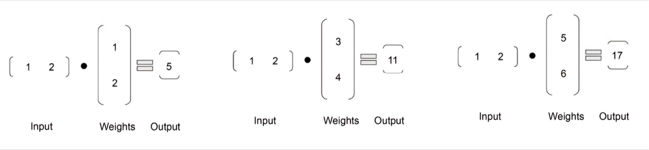
Splitting the matrix calculation

Slide 16
Distributed Training Frameworks
Megatron-LM by Nvidia: Combines data, tensor, and pipeline parallelism for extreme scalability.
DeepSpeed by Microsoft: Implements Zero Redundancy Optimizer (ZeRO) to minimize memory footprint.
SageMaker Distributed Training Library: Automates model splitting and handles infrastructure.
FairScale by Facebook: Supports data and model parallelism with optimization utilities.

Slide 17
Achieving Low-Latency Model Inference
Importance of Low-Latency Inference: Critical for real-time applications like fraud detection.
Optimization Methods: Model compression, hardware acceleration, and inference engine tuning.
Key Considerations: Reducing model size, improving computational efficiency, and minimizing data movement.

Slide 18
Hardware Acceleration for Inference
CPU Characteristics: General-purpose, high-memory, limited parallelism, suitable for non-time-critical inferences.
GPU Characteristics: Many cores, optimized for parallel tasks, excels in matrix operations.
ASICs and TPUs: Customized for specific operations; higher efficiency and lower latency.

Slide 19
Model Optimization Techniques
Quantization: Uses lower precision data (e.g., INT8) to reduce model size with minimal accuracy loss.
Pruning (Sparsity): Removes unnecessary weights, reducing computational load without affecting output.
Mixed-Precision Training: Combines high and low precision calculations to optimize performance.

Slide 20
Quantization Methods
Uniform Quantization: Maps values to a consistent scale for easy compression.
Non-Uniform Quantization: Allows flexibility by mapping values with varying scales.
Post-training Quantization: Applies quantization after model training.
Quantization-Aware Training: Adjusts model during training to retain accuracy with quantization.

Slide 21
Pruning Strategies
Magnitude-Based Pruning: Removes weights below a certain threshold.
Penalty-Based Pruning: Modifies loss function to push unneeded weights to zero.
Dropout Removal: Eliminates dropout layers for inference, reducing model complexity.
Regularization and Reinforcement Pruning: Uses regularization techniques and reinforcement learning for optimal pruning.

Slide 22
Graph and Operator Optimization
Graph Optimization Techniques: Reduces operations in computation graphs to improve latency.
Operator Fusion: Combines multiple operations to minimize memory access time.
Constant Folding: Pre-computes static values to streamline runtime processing.

Slide 23
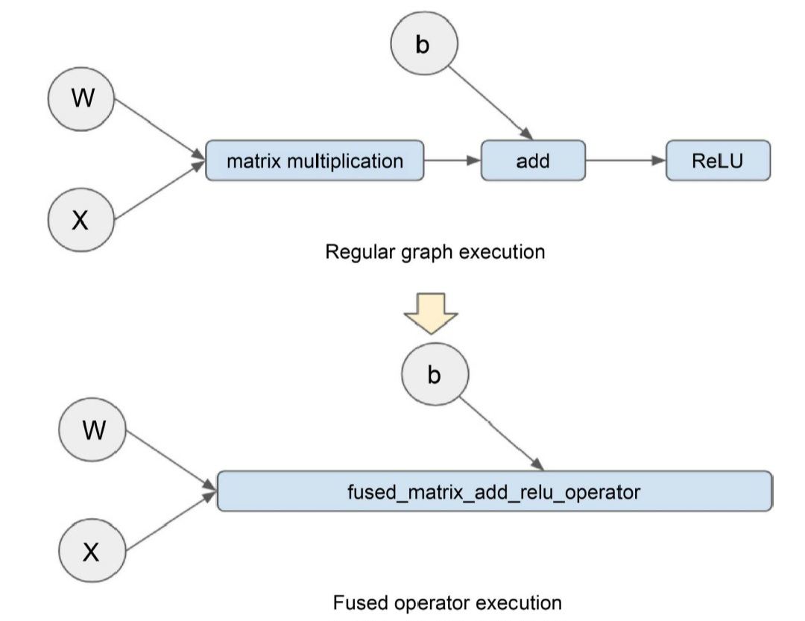
Graph operator fusion

Slide 24
Model Compilers for Optimization
TensorFlow XLA: Converts TensorFlow graphs into optimized execution kernels.
PyTorch Glow: Uses intermediate representations for layer- and memory-level optimizations.
Apache TVM: Compiles models from various frameworks for optimized hardware execution.
SageMaker Neo: Uses TVM backend, compiles models for efficient deployment on SageMaker.

Slide 25
Inference Engine Optimization Techniques
Batching Inference Requests: Groups requests to reduce overhead and increase throughput.
Parallel Serving Sessions: Utilizes multiple cores for parallel processing.
Communication Protocols: Use of gRPC over REST for faster request handling in certain cases.

Slide 26
Inference for Large Language Models
Challenges with Large Models: Often exceed single-device memory, requiring distributed processing.
Text Generation Inference (TGI): Provides quantization and tensor parallelism for Hugging Face models.
DeepSpeed-Inference: Optimizes inference with model parallelism and kernel fusion.
FastTransformer by Nvidia: Accelerates transformer models with optimized GPU kernels.

Slide 27
Hands-On Lab – Distributed Training with PyTorch
Objective: Train a financial sentiment model on multiple GPUs using distributed data parallelism.
Key APIs Used: PyTorch’s DistributedDataParallel for scalable model training.
Dataset and Setup: Uses Kaggle’s financial sentiment dataset for real-world scenario.
Instructions Overview: Steps to initialize training, configure GPUs, and optimize model across nodes.

Slide 28
Summary and Key Takeaways
Distributed Training Recap: Data and model parallelism are critical for scaling large models.
Inference Optimization: Techniques like quantization, pruning, and hardware acceleration for faster predictions.
Practical Skills: Importance of selecting the right architecture and frameworks for scalable ML engineering.
Final Thoughts: Encourage exploration of distributed training methods and optimizations in real projects.

